Slide 1
Predict Success of Movies Based on Social Media
Advanced Information Retrieval CSE635
Project by:
Team 12

Slide 2
Architecture:
Twitter Feed
Sentiment Analysis
Predictive Model
UI
IMDB, Box Office Mojo etc..
Performance Scores

Slide 3
Architecture:
Collected ~150K tweets of different movies.
Sentiment classifier trained initially with NLTK/short reviews corpus – Pang Lee.
Additionally, tweets collected were used to train classifier to get higher accuracy.
Twitter Feed
Sentiment Analysis
Predictive Model
UI
IMDB, Box Office Mojo etc..
Performance Scores

Slide 4
Architecture:
Twitter Feed
Sentiment Analysis
Predictive Model
UI
IMDB, Box Office Mojo etc..
Performance Scores
Performance score for each actor and director calculated on basis of all movies they have acted or directed in.
Logistic Regression used to compute over all score for the movie – used in Analytical Model.

Slide 5
Architecture:
Prediction based on Sentiment Score (Aggregate of Sentiments received) and score computed through Logistic Regression.
Sentiment Score – P/N ratio aggregation pseudocode from Lexalytics inc. https://www.lexalytics.com
Twitter Feed
Sentiment Analysis
Predictive Model
UI
IMDB, Box Office Mojo etc..
Performance Scores

Slide 6
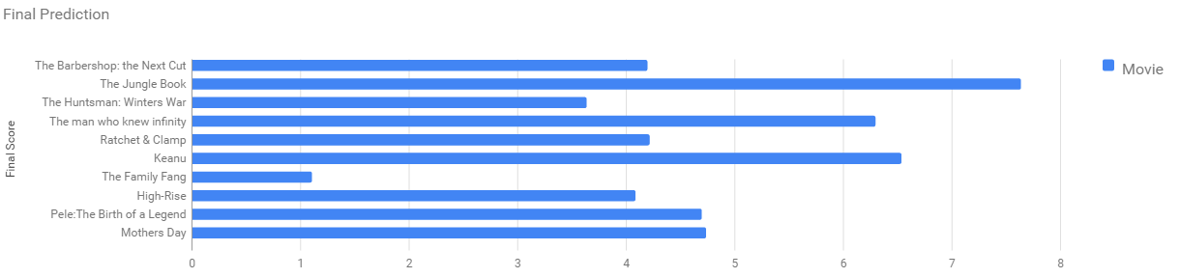
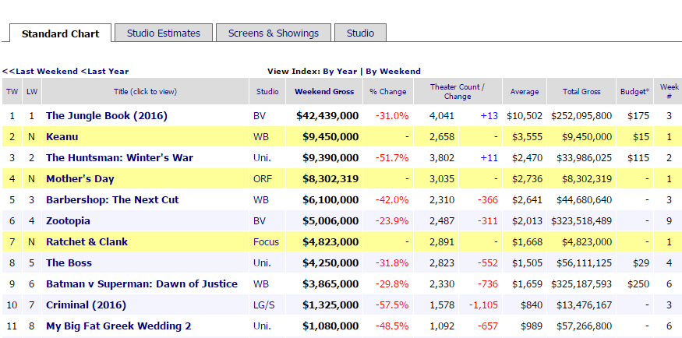
Prediction:
The prediction is similar IMDB Metascore ratings and also correlate to the weekend box office results released by Box Office Mojo.
http://www.boxofficemojo.com/weekend/chart/?yr=2016&wknd=18&p=.htm
http://www.imdb.com/movies-in-theaters/?ref_=cs_inth
Note: All tweets are collected prior to release of the said movies.

Slide 7
Evaluation:
Classifier trained on polarity short reviews corpus – NLTK/Pang Lee.
To increase accuracy, the classifier was trained on tweets we crawled for the selected movies.
Accuracy: f-measure:
Accuracy of scores obtained from IMDB, RottenTomatoes = 59.7%
Feature List used to train Logistic Regression Model
Movie | Accuracy
The Jungle Book | 73.07%
The Huntsman: Winters War | 56.10%
The Barbershop: Next Cut | 68.22%
Ratchet & Clank | 67.34%
Keanu | 73.41%
Mother's Day | 62.25%
High-Rise | 60.00%
The Family Fang | 54.70%
Pele: Birth of a Legend | 60.31%
Movie | f-measure
 | Pos Tweets | Neg Tweets
The Jungle Book | 0.717 | 0.675
The Huntsman: Winters War | 0.411 | 0.526
The Barbershop: Next Cut | 0.622 | 0.562
Ratchet & Clank | 0.512 | 0.615
Keanu | 0.783 | 0.655
Mother's Day | 0.445 | 0.397
High-Rise | 0.615 | 0.285
The Family Fang | 0.394 | 0.473
Pele: Birth of a Legend | 0.561 | 0.637

Slide 8
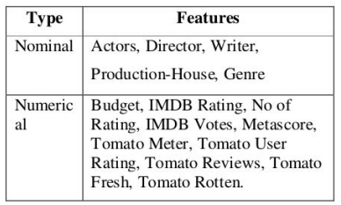
Evaluation:
Classifier trained on polarity short reviews corpus – NLTK/Pang Lee.
To increase accuracy, the classifier was trained on tweets we crawled for the selected movies.
Accuracy: f-measure:
Accuracy of scores obtained from IMDB, RottenTomatoes = 59.7%
Dataset used to train Logistic Regression Model
Movie | Accuracy
The Jungle Book | 73.07%
The Huntsman: Winters War | 56.10%
The Barbershop: Next Cut | 68.22%
Ratchet & Clank | 67.34%
Keanu | 73.41%
Mother's Day | 62.25%
High-Rise | 60.00%
The Family Fang | 54.70%
Pele: Birth of a Legend | 60.31%
Movie | f-measure
 | Pos Tweets | Neg Tweets
The Jungle Book | 0.717 | 0.675
The Huntsman: Winters War | 0.411 | 0.526
The Barbershop: Next Cut | 0.622 | 0.562
Ratchet & Clank | 0.512 | 0.615
Keanu | 0.783 | 0.655
Mother's Day | 0.445 | 0.397
High-Rise | 0.615 | 0.285
The Family Fang | 0.394 | 0.473
Pele: Birth of a Legend | 0.561 | 0.637
Feature Set:
Accuracy when trained on 200 samples

Slide 9
Thank You.
Demo Link : http://ec2-52-36-39-53.us-west-2.compute.amazonaws.com:8080/prediction.html

